Slide 1
6
INFINITE SEQUENCES AND SERIES
Copyright © Cengage Learning. All rights reserved.

Slide 2
6.4
Other Convergence Tests
Copyright © Cengage Learning. All rights reserved.

Slide 3
Alternating Series

Slide 4
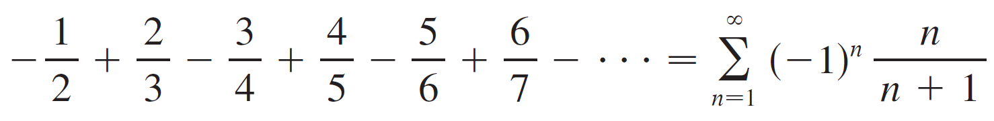

Alternating Series
An alternating series is a series whose terms are alternately positive and negative.
Here is an example:
We see from this example that the nth term of an alternating series is of the form
where b_{n} is a positive number. (In fact, b_{n} = |a_{n}|.)

Slide 5
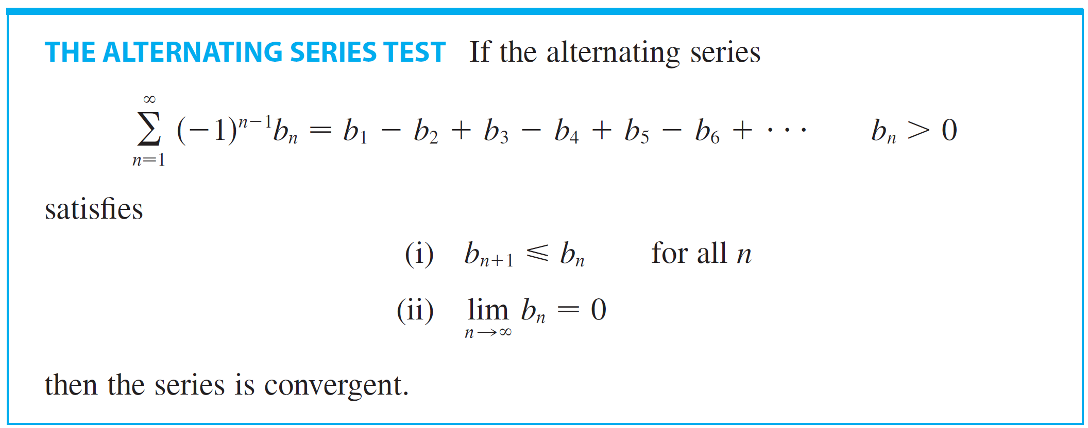
Alternating Series
The following test says that if the terms of an alternating series decrease to 0 in absolute value, then the series converges.

Slide 6
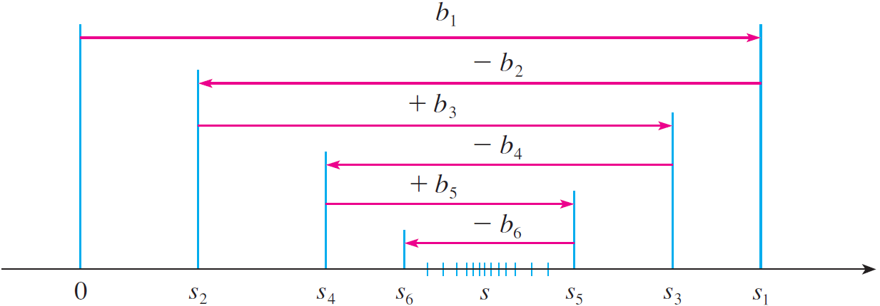
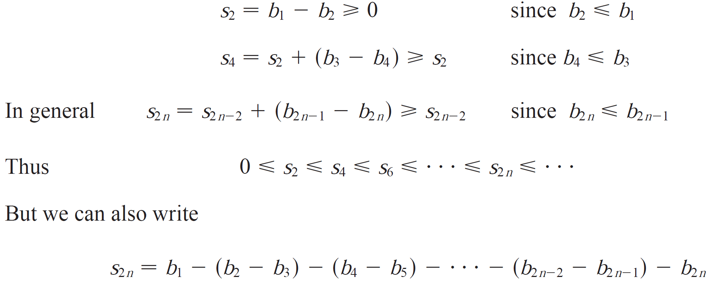
Alternating Series
Proof: Consider the partial even sums

Slide 7


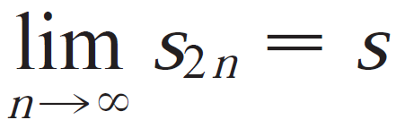
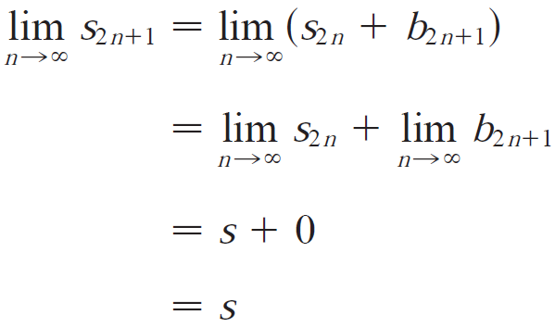

Alternating Series
Every term in brackets is positive, so for all n. Therefore the sequence is increasing and bounded above. By the Monotonic Sequence Theorem, it is convergent.
Now, we compute the limit of the odd partial sums:
Since both the even and odd partial sums converge to the same value s, the series is convergent with .

Slide 8
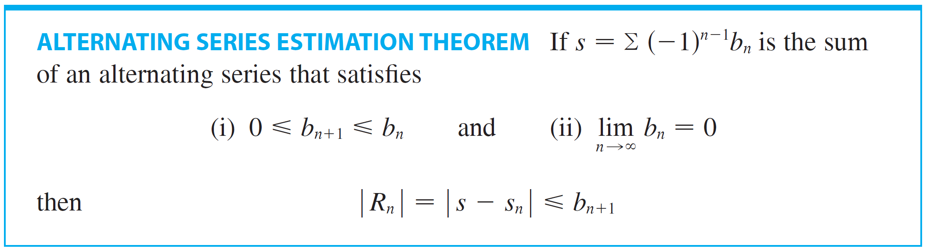
Alternating Series
The next theorem says that for series that satisfy the conditions of the Alternating Series Test, the size of the error is smaller than b_{n + 1}, which is the absolute value of the first neglected term.

Slide 9
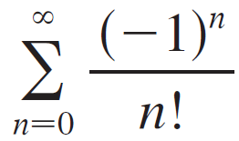
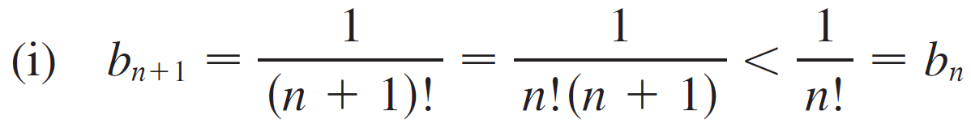
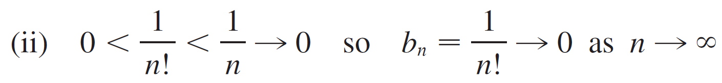
Example 4
Find the sum of the series correct to three
decimal places.(By definition, 0! = 1.)
Solution:
We first observe that the series is convergent by the Alternating Series Test because

Slide 10
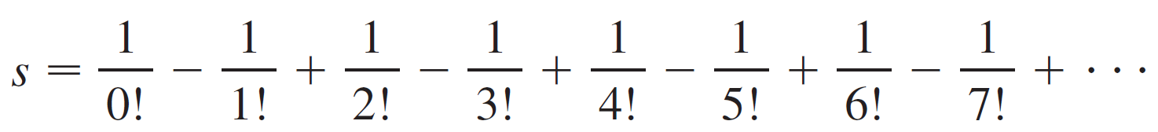
Example 4 – Solution
cont’d
To get a feel for how many terms we need to use in our approximation, let’s write out the first few terms of the series:

Slide 11


Example 4 – Solution
cont’d
Notice that
and
⁰

Slide 12


Example 4 – Solution
cont’d
By the Alternating Series Estimation Theorem we know that
This error of less than 0.0002 does not affect the third decimal place, so we have
correct to three decimal places.

Slide 13
Absolute Convergence

Slide 14
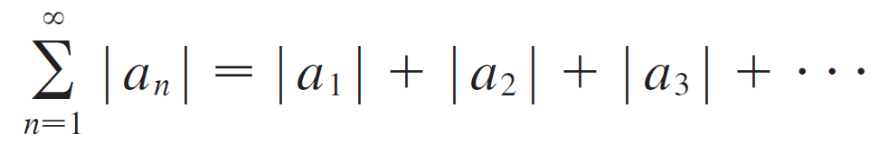
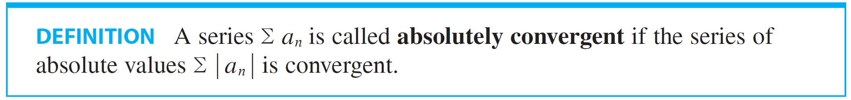
Absolute Convergence
Given any series Σ a_{n}, we can consider the corresponding series
whose terms are the absolute values of the terms of the original series.
Notice that if Σ a_{n} is a series with positive terms, then
|a_{n}| = a_{n} and so absolute convergence is the same as convergence.

Slide 15
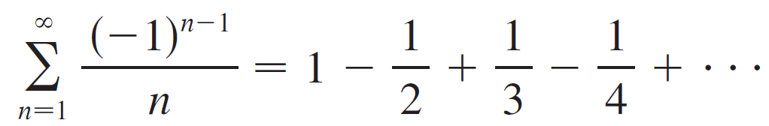
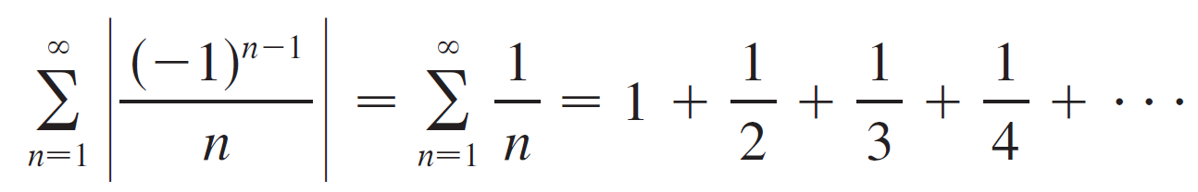
Example 6
We know that the alternating harmonic series
is convergent, since it satisfies the Alternating Series Test, but it is not absolutely convergent because the corresponding series of absolute values is
which is the harmonic series (p-series with p = 1) and is therefore divergent.

Slide 16

Absolute Convergence
It is possible for a series to be convergent but not absolutely convergent.
However, the next theorem shows that absolute convergence implies convergence.

Slide 17
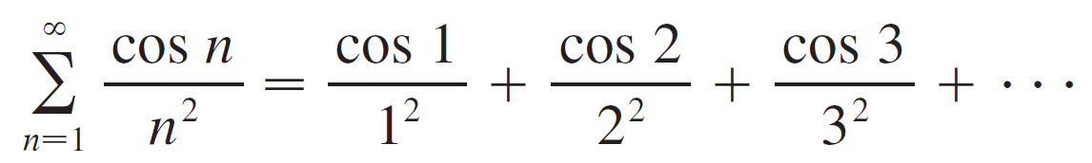
Example 7
Determine whether the series
is convergent or divergent.
Solution:
This series has both positive and negative terms, but it is not alternating. (The first term is positive, the next three are negative, and the following three are positive. The signs change irregularly.)

Slide 18
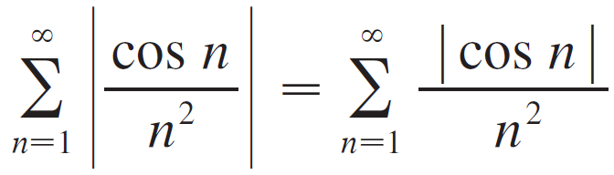

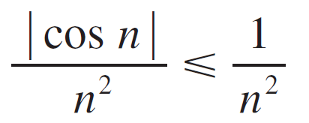
Example 7 – Solution
cont’d
We can apply the Comparison Test to the series of absolute values
Since for all n, we have

Slide 19
Example 7 – Solution
cont’d
We know that Σ 1/n² is convergent (p-series with p = 2) and therefore Σ | cos n | /n² is convergent by the Comparison Test.
Thus the given series Σ (cos n)/n² is absolutely convergent and therefore convergent by Theorem 1.

Slide 20
The Ratio Test

Slide 21
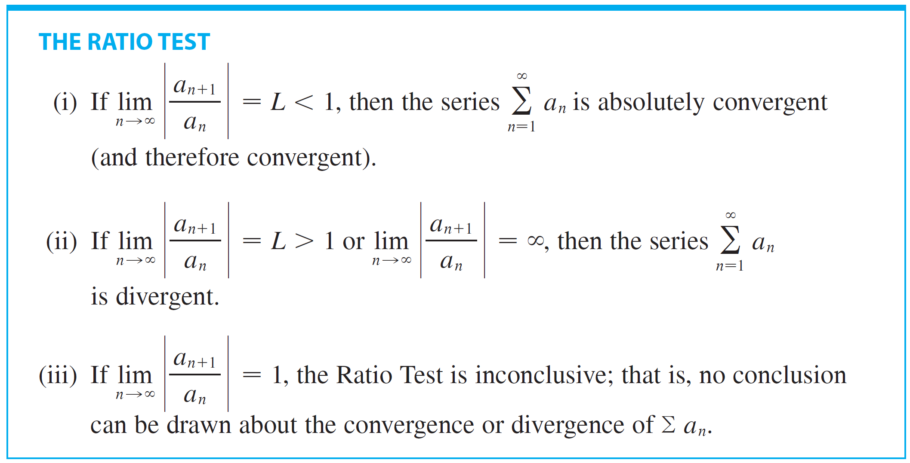
The Ratio Test
The following test is very useful in determining whether a given series is absolutely convergent.

Slide 22
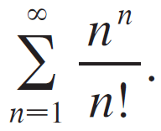

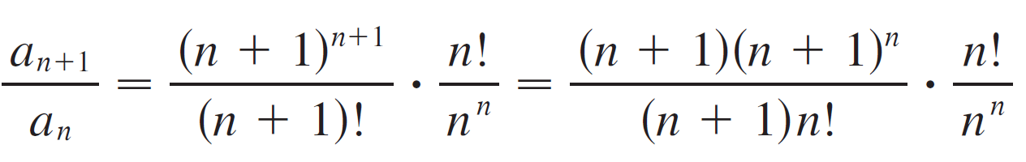
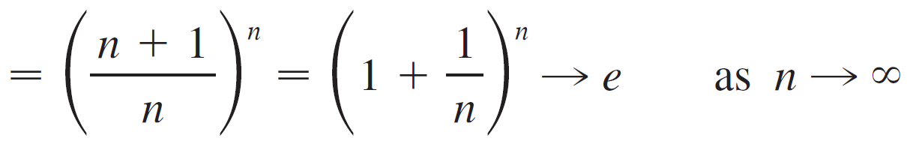
Example 9
Test the convergence of the series
Solution:
Since the terms are positive, we don’t need the absolute value signs.
Since e > 1, the given series is divergent by the Ratio Test.

Slide 23
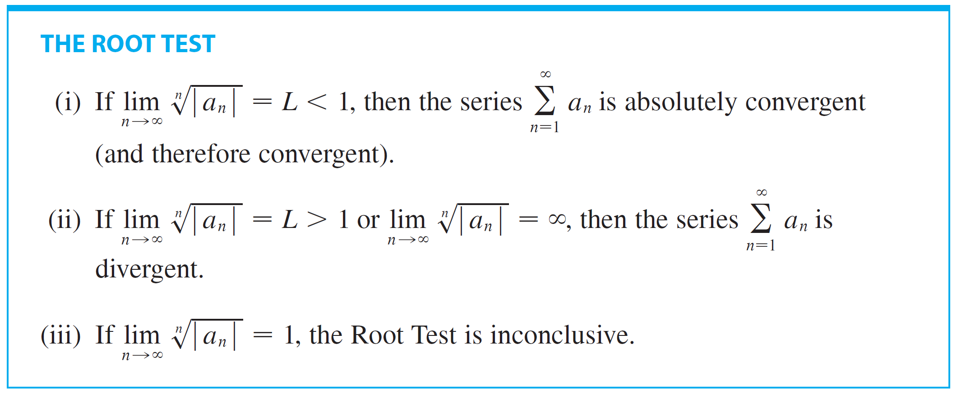
The Ratio Test
The following test is convenient to apply when nth powers occur.

Slide 24
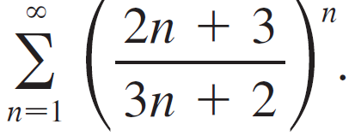
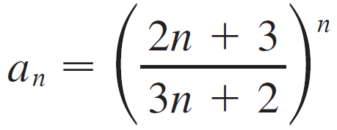
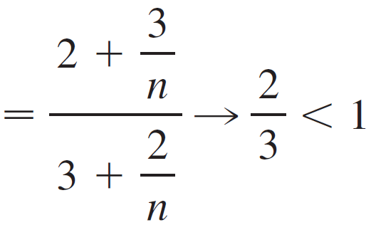
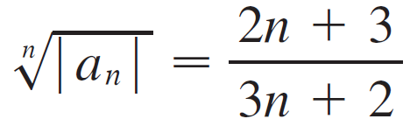
Example 10
Test the convergence of the series
Solution:
Thus the given series converges by the Root Test.

Slide 25
Proof of the Ratio Test

Slide 26
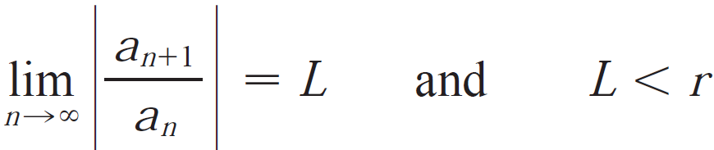

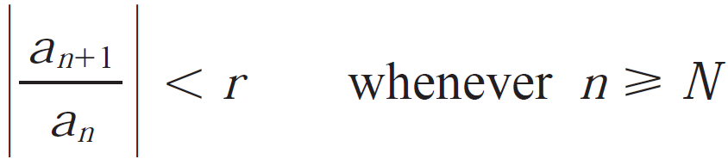

The Ratio Test
Proof:
(i) The idea is to compute the given series with a convergent geometric series. Since L < 1, we can choose a number r such that L< r < 1. Since
the ratio will eventually be less that r; that is, there exists an integer N such that
or, equivalently,

Slide 27
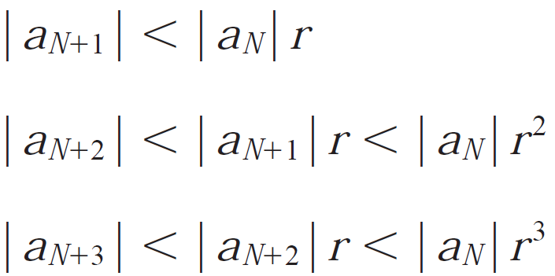

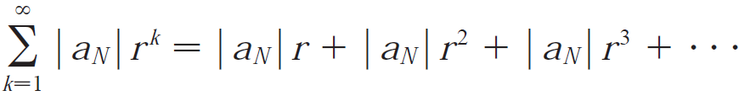
The Ratio Test
Putting n successively equal to N, N+1, N+2,…, we have
and in general,
Now the series is convergent because it is a geometric series with 0 < r < 1. So the inequality 5 together with the Comparison Test shows that the series
is also convergent.

Slide 28


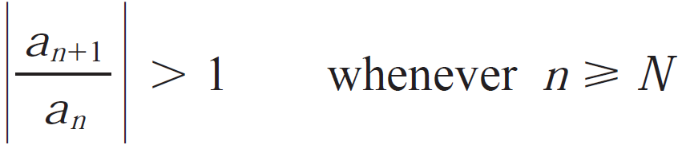
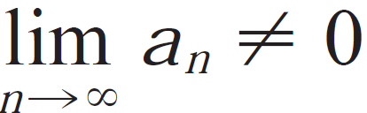

The Ratio Test
It follows that the series is convergent. (Recall that a finite numbers of terms does not affect convergence.) Therefore is absolutely convergent.
(ii) If → L > 1 or → ∞, then the ration will eventually be greater than r; that is, there exists an integer N such that
which means , and so
Therefore is divergent by the Test for Divergence.

Slide 29



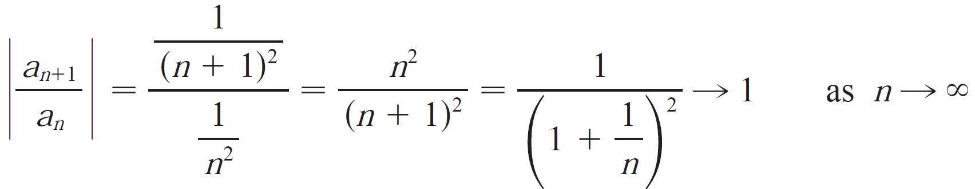
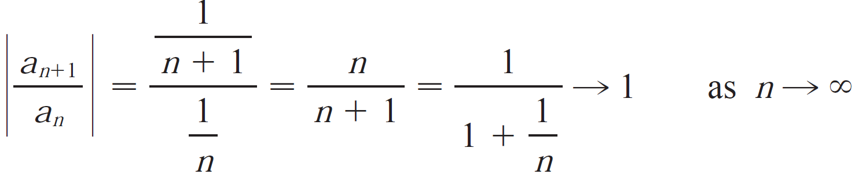

The Ratio Test
Note: Part (iii) of the Ration Test says that if
the test gives no information.
For instance, consider two series (convergent) and
(divergent), but the ratio limits for these series are both 1.
Therefore, if , the series might converges it diverges. In this case, the ratio test fails and we must use some other test.

